Slide 1
Section 6.2
Probability Rules:
Independent Events, Complement, and CONDITIONAL Probability
The Idea of Probability

Slide 2
What’s Important:
Definition of “Independent Events” , if two events are “independent” then the probability of event “A” and “B” occurring together will be:
Ie: 25% of men are colour blind, 10% are obese. So the probability of obese men that are colour blind would be: 0.25 x 0.10 = 2.5%
Definition of Probability: The probability of an event is equal to the number of desired outcomes divided by the total number of outcomes, IF and ONLY IF every outcome is equal
Conditional Probability: the denominator of a probability changes when we are “given” or “know” something about the outcome
  Best to use “VENN Diagrams” when dealing with conditional probability
  Only use “TREE Diagrams” if the events are “independent”
Law of Large Numbers: as the number of trials increase, the results experimental outcomes will gravitate towards the results of theoretical outcomes

Slide 3
What is Independence?
An example between two variables that are independent amongst men [30-45] is being “obese” and being “color blind”
When two variables are independent, the ratios with or without the 2nd variable will stay the same
Amongst all the men that were obese, 7.4% were color blind
Color Blind
Not Color Blind
Obese
55
685
Amongst all the men that were NOT obese, also around 7.4% were color blind
Not Obese
113
1410
In both cases, Obese or Not obese, around 7.4% of men were color blind.
Ie: Being obese doesn’t make you more likely to be colorblind. So the two variables are independent

Slide 4
Main Probability Rules For AP Statistics
Rule #1) When two events “A” and “B” are “independent”, the probability of both events happening at the same time is:
If you want to check if two events are independent, use this formula!!
Rule #2) When two events “A” and “B” are “Dependent”, then we have:
When “A” occurs, “B” is also more likely to occur. Vice versa
When “A” occurs, “B” is less likely to occur
Rule #3) When two events “A” and “B” are “Mutually Exclusive”, they can not happen at the same time!! Ie: if “A” occurs, then “B” can not happen
The two events are mutually exclusive
Note: When two events are mutually exclusive, they are NOT independent. Instead, they are negatively dependent. One happens, the other can NOT happen

Slide 5
What is Conditional Probability P(B|A)
“Conditional” – the probability of an event when certain conditions are revealed or given to you
P(B|A) – the probability that event ‘B’ will occur, GIVEN that event ‘A’ has already occurred
When event “A” has already happened, the denominator of the probability would be P(A)
Since “A” has already occurred, the probability of event “B” would then be P(A & B)
Ie: What is the probability that you rolled a 4 if the number you rolled is even?
The probability that
“B’ will occur
Given that event
‘A’ has occurred
“given” symbol
Since it’s given that the roll is even, it can only be 2, 4 or 6
© Copyright all rights reserved to Homework depot: www.BCMath.ca

Slide 6
Ex: A: marble is in Circle A, B: Marble is in circle B. Find the following conditional Probability
Given that a marble is in circle B
A
B
The probability that it is circle A
Given that a marble is in circle A
The probability that it is in circle B
Given that a marble is in NOT circle B
The probability that it is in circle A
Given that a marble is in circle A or circle B
The probability that it is in circle B
© Copyright all rights reserved to Homework depot: www.BCMath.ca

Slide 7
“AND” vs “OR” Events
When looking for the event “A and B”, these are events that are in BOTH circles at the same time
A
B
When looking for the event “A or B”, these are events that are in EITHER circles
A
B

Slide 8
FINDING $P(A or B)$
$P(A or B)$is the event where you include everything that is in EITHER event ‘A” or event “B”

Slide 9
Using VENN Diagrams for Conditional Probability
Conditional probability is used when an event is given to be true
The given information will affect the denominator of your probability
Ie: What is the probability that a ball is in circle “A” given that it is in circle B
A
B
Ie: What is the probability that a ball is in circle “B” given that it is NOT in circle A
A
B

Slide 10
Independent Events
When two events are independent, it means that the outcome of one event will not affect the outcomes of another
The probability of two independent events happening together will be the product of their probabilities:
Only true if A and B are independent
NOT independent, positive association
NOT independent, negative association
Ie: The probability that it will rain tomorrow is 60% and the probability that an earthquake (within 100km) occurs is 0.15%. What is the probability that an earthquake and rain will occur tomorrow?
There is a 0.09% (9/10,000) chance that an earthquake (within 100km) and rain will occur tomorrow.

Slide 11
Ex: The probability that Jack will be promoted is 30% and the probability that his wife will find a new job is 43%. If the probability that both events will occur is 0.189, then answer the following:
a) What are the two events?
b) Suppose the two events are independent, what is the probability that they both occur?
c) You are given the probability of both events occurring, what does this mean? Is there a positive or negative association with the two events? Describe what this association means?
e)What is the probability that both events will not occur together?
P(Jack)=0.3
The event that Jack will be promoted
P(Wife)=0.43
The event that the wife will find a new job
If the two events are
independent then:
P(Jack & Wife) = P(Jack)xP(wife)
=0.3x 0.43 = 0.129
Since: P(jack and wife) > P(Jack) x P(wife)
It means that there is a positive association with the two events
If Jack gets promoted, it increases the probability that his wife will
also find a new job
This one is tricky……P(Both events not occur together) =1 - P(Jack & Wife)
=1 - 0.129 = 0.871

Slide 12
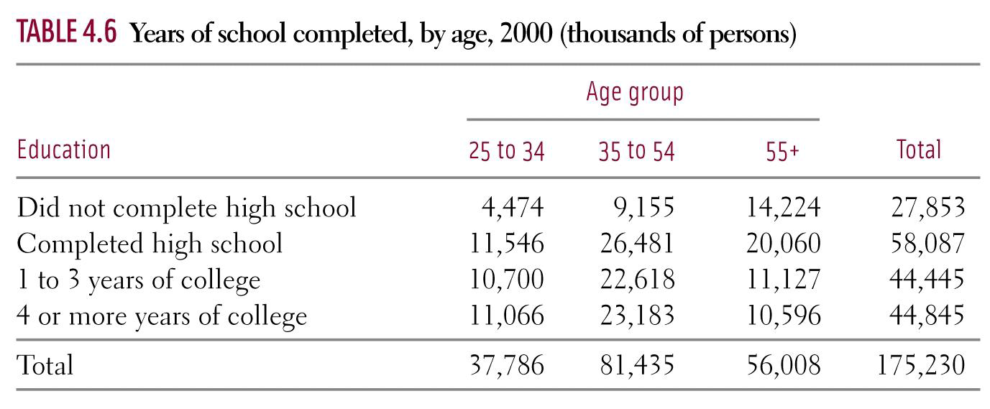
i) What is the probability that someone chosen at random is between ages 35 to 54?
ii) What is the probability that someone chosen at random has 1 to 3 years of college education?
iii) What is the probability that someone chosen at random did not complete HS?
iv) What is the probability that someone chosen at random did not complete HS and is 55+ in age?
iv) What is the probability that someone chosen at random has 4+ years of college educt and is b/n 25 to 34?

Slide 13
i) Suppose P(A) Is selecting someone 55+ in age and P(B) is selecting someone that did not complete HS. Are these two events independent, positively, or negatively correlated? Explain:
ii) Suppose P(A) Is selecting someone 55+ in age and P(C) is selecting someone with 4+ yrs of college education. Are these two events independent, positively, or negatively correlated? Explain:
iii) Suppose P(D) Is selecting someone b/n 25 to 34 in age and P(C) is selecting someone with 4+ yrs of college education. Are these two events independent, positively, or negatively correlated? Explain:

Slide 14
i) Given that we selected someone b/n 35 to 54, what is the probability that they have 4+ years of college education?
ii) Given that we selected someone with 1 to 3 years of college, what is the probability that they are between 25 to 34? Explain:
iii) What is the probability of selecting someone that is either 25 to 34 in age or has 4 or more years of college education?
iv) What is the probability of selecting someone that is neither 55+ in age or did not complete 4 or more years of college education?

Slide 15
Ex: Police report that 78% of drivers are given a breath test, 36% a blood test, and 22% are given both tests.
a) Are giving a DWI suspect a blood test and a breath test mutually exclusive?
b) Are giving the two tests independent?
c) Given that a driver already had a breath test, what is the probability that they will also get a blood test?
Soln: State the events we’re interest in.
Let A = {suspect is given a breath test}.
Let B = {suspect is given a blood test}.
a) If the two events are mutually exclusive then:
Since the intersection is not empty, then they are not M.E.
b) If the two events are independent then:
Not equal, so not independent

Slide 16
Ex: Police report that 78% of drivers are given a breath test, 36% a blood test, and 22% are given both tests.
a) Are giving a DWI suspect a blood test and a breath test mutually exclusive?
b) Are giving the two tests independent?
c) Given that a driver already had a breath test, what is the probability that they will
also get a blood test?
Let A = {Event that suspect is given a breath test}.
Let B = {Event that suspect is given a blood test}.
A
B

Slide 17
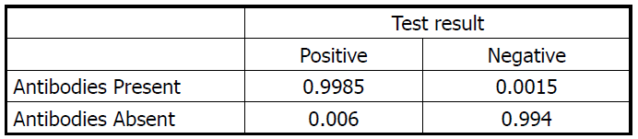
Example –Page 378, #6.64
Ex: Enzyme immuno-assay (EIA) tests are used to detect the presence of HIV antibodies, the virus that causes AIDS. These antibodies indicate the presence of the virus. The test is only 99.85% accurate. Which means, if you have the antibodies, the tests will come back 99.85% positive. Probabilities are listed below: (NOTE: It is estimated that 1% of the population have HIV antibodies in their blood)
Note: Someone who is HIV positive may be unaware of their disease. When the EIA test is performed, they don’t actually know their medical condition
So cases of a false positive or a false negative can occur!
False positive – you don’t have HIV but tests say Positive
False negative – you have HIV but tests say Negative

Slide 18
A) Create a TREE or VENN diagram to illustrate the probability of events
B) What is the probability that someone who got tested positive and does actually have HIV?
C) What is the probability that someone got tested positive but doesn’t actually have HIV? Is this high or low?
D) What is the probability of a false negative? When someone is tested negative for HIV, but actually has HIV? Which is more likely? False positive or False negatives?
E) Many medical professionals would claim that this test is
99.85% accurate, but what does this percentage actually imply? How reliable is this test? Why is it accurate or inaccurate?

Slide 19
These two percentages add to 100%
The ratios of people with HIV to without HIV is 1 to 99
Imagine we have 1,000,000 people: HIV – 10,000 NO HIV – 990,000
Use these numbers to recreate the box
HIV 10,000
9985
15
No HIV 990,000
5940
984,060

Slide 20
HIV 10,000
9985
15
No HIV 990,000
5940
984,060
B) What is the probability that someone who got tested positive and does actually have HIV?
C) What is the probability that someone got tested positive but doesn’t actually have HIV? Is this high or low?
D) What is the probability of a false negative? When someone is tested negative for HIV, but actually has HIV? Which is more likely? False positive or False negatives?
E) Many medical professionals would claim that this test is 99.85% accurate, but what does this percentage actually imply? How reliable is this test?
Why is it accurate or inaccurate?

Slide 21
A) Given that the test shows
positive, what is the probability
that they have HIV
1
1
3
1
2
3
4
B) Given that the test shows
positive, what is the probability
that they don’t have HIV
3
1
3

Slide 22
C) Given that the test shows
negative, what is the probability
that they have HIV
2
2
4
1
2
3
4
D) A 99.85% accuracy in this case implies that the test will detect the antibody 99.85 out of 100 times if you actually have the virus. However, it does not imply that if the test shows positive, then you are 99.85% HIV positive. Instead, if the test shows positive, then there is only 62.7% that you actually have HIV.
The probability is low because only a small percentage of our population has HIV

Slide 23
Example –Page 370, #6.56
Ex: Choose an employed person at random. Let “A” be the event that the person chosen is a women and “B” the event that the person holds a managerial or professional job. Government data tell us that P(A) = 0.46 and the probability of managerial and professional jobs among women is P(B|A) = 0.32.
Find the probability that a randomly chosen employed person is a women holding a managerial or professional position.

Slide 25
The probability that a vaccine for covid will be available by Feb is 48%. The probability that schools will shut down in BC is 25%. The probability that a federal election will happen next year is 85%. Find the probability of the following:
i) The probability of all three events in happening:
ii) The probability of getting a vaccine by Feb and also a federal election, but not school closing:
iii) Find the probability of only one of these events in happening:

Slide 26
If P(A) = 0.3, P(B) = 0.5, and P(A and B) =0, which of the following statements are true?
i) Events A and “B” are independent
ii) P(A^{c} and B^{c}) =0
iii) P(A^{c} and B) = P(B)
iv) P(A or B) = P(A) + P(B)

Slide 27
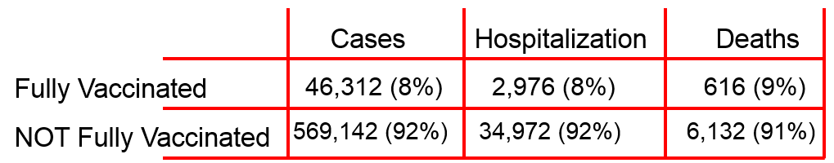
Data from US citizens in 13 jurisdiction from Apr 4 – June 19 and June 20 to July 17,2021. A comparison b/n fully vaccinated and not fully vaccinated with cases, hospitalization, and deaths.
https://www.cdc.gov/mmwr/volumes/70/wr/mm7037e1.htm?s_cid=mm7037e1_w
i) Suppose a random person selected got covid, what is the probability that they were vaccinated?
ii) Suppose a random person selected was hospitalized with covid, what is the probability that they were not vaccinated?
iii) Suppose a random person selected died due to covid, what is the probability that they were not vaccinated?
iv) Is this data strong evidence that vaccination helps prevents covid cases, hospitalization and deaths due to covid?

Slide 28
The trial enrolled 30,415 participants; 15,209 were assigned to receive the mRNA-1273 vaccine, and 15,206 to receive placebo. More than 96% of participants received both injections, 2.3% had evidence of SARS-CoV-2 infection at baseline, and the median follow-up was 5.3 months in the blinded phase. Vaccine efficacy in preventing Covid-19 illness was 93.2% (95% confidence interval [CI], 91.0 to 94.8), with 55 confirmed cases in the mRNA-1273 group (9.6 per 1000 person-years; 95% CI, 7.2 to 12.5) and 744 in the placebo group (136.6 per 1000 person-years; 95% CI, 127.0 to 146.8). The efficacy in preventing severe disease was 98.2% (95% CI, 92.8 to 99.6), with 2 cases in the mRNA-1273 group and 106 in the placebo group, and the efficacy in preventing asymptomatic infection starting 14 days after the second injection was 63.0% (95% CI, 56.6 to 68.5), with 214 cases in the mRNA-1273 group and 498 in the placebo group. Vaccine efficacy was consistent across ethnic and racial groups, age groups, and participants with coexisting conditions. No safety concerns were identified.
https://www.nejm.org/doi/full/10.1056/NEJMoa2113017#article_references

Slide 29
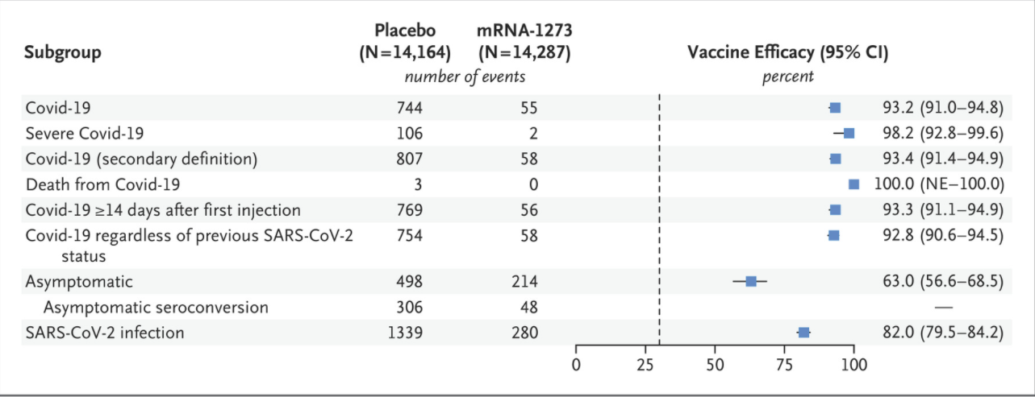

Slide 30
https://www.cochrane.org/CD013705/INFECTN_how-accurate-are-rapid-tests-diagnosing-covid-19
Covid 19 rapid tests are 72% accurate with patients that have covid symptoms. In people without covid, covid 19 antigen tests were 99.5% accurate. What is the probability of the following:
i) A False positive – you don’t have covid but the tests says you do
ii) A false negative – you have covid but the tests says you don’t

Slide 31
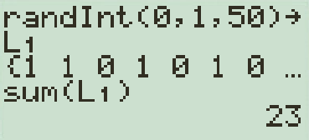
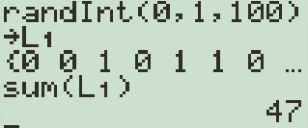
Randomness
Even though the outcomes of individual experiments can not be predicted (ie: tossing a coin, rolling a dice), there is a pattern if the experiment is repeated many times.
Example: If I have a coin and flipped it once, I can not predict the outcome. However, if we flip the coin many times, we can predict the number of heads that appear.
  A) Using your Ti-83, simulate flipping a coin i) 50 times ii) 100 times and record how many heads you get.
Use randInt and let 0 – tails and 1 – heads, store in L₁
Press:
MATH
PRB
5:randInt(
,
,
0
1
50
STO→
L₁
LIST
MATH
5:SUM
L₁
)

Slide 32
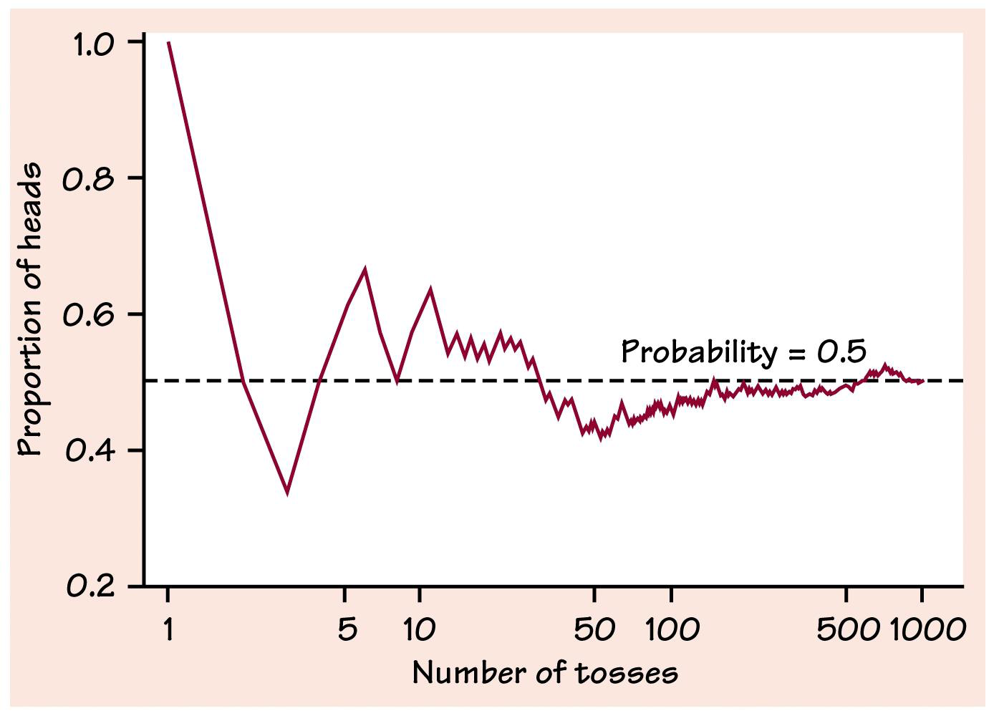
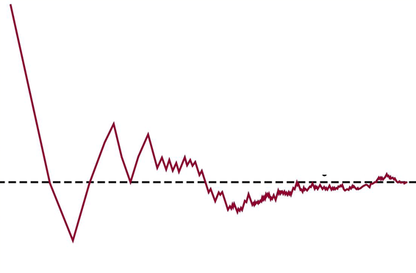
Chance behaviour is unpredictable in the short run but has a regular and predictable pattern in the long run
ie: When tossing a coin, we can not predict the next outcome
However, in 1000 tosses, we can predict that heads will appear about 50% of the time

Slide 33
Simulating Probability Events
When it is too complicated to calculate the probability, use simulation!
Use table of Random Digits to simulate events
  Challenge: Assign your digits that will reflect outcomes with the same probabilities
Q: How will you use Table of Random digits to simulate the sum from rolling two die?
  Note: NOT all sums have equal probability!!!
  Can’t just use digits 02, 03, …., 12 to represent the outcomes!

Slide 34
Simulation Experiment:
When you flip a coin 100 times, how likely is it to have 5 heads or 5 tails in a row?
i) Use the table of random digits to simulate this activity of flipping a coin 100 times to find the prob of getting a string of 5 heads or tails in row
ii) Use a coin and record your outcomes of 100 flips. Did you get a string of 5 heads or tails?
iii) Have everyone in your class perform atleast one trial of this activity. What do you think is the probability that a string of 5H or 5T will appear in 100 toss?

Slide 35
Basic Probability Rules
The probability of an outcome is the proportion of times the outcome would occur for a large number of repetitions.
Probability - the likelihood or chance that an event will occur, ranging from zero to one (100%)
P(A) –the probability of event “A”
If P(A) = 0, then event “A” is impossible
If P(A) = 1, then event “A” will happen for sure

Slide 36
Example – Page 334, #6.4
Given each probability value on the left, indicate which description best describes it.
A). This event is impossible.
It can never occur.
B). This event is certain.
It will occur on every trial
of the random phenomenon.
C). This event is very unlikely,
but it will occur once in a
while in a long sequence of trials.
D). This event will occur
more often than not.
P(x)= 1
P(x)= 0.01
P(x)= 0
P(x)=0.6

Slide 37
Terms: Outcomes and Events
When you perform an experiment, there is a set of outcomes that you can expect
  Ie: rolling a dice the outcomes are 1, 2, 3, 4, 5, and 6
Outcome: the result from a single trial of an experiment
Events are different from outcomes. Events include a desired outcome or a set of outcomes from an experiment
  the event of rolling an even number {2,4,6}
  a number less than 5 {1,2,3,4}
  a prime number {2,3,5}
  rolling a 4,...etc
Sample Space: a list of all the outcomes from an experiment
  ie: When rolling a dice, the sample space is: 1,2,3,4,5, and 6

Slide 38
What is the sample space for the following?
i) Flipping 4 coins and recording the number of heads and Tails:
ii) Rolling 3 die and getting the sum:
iii) Randomly selecting one day of a week that ends with the letter “y”
iv) Randomly selecting a name for your son that begins with the letter “P”

Slide 39
Complement Events:
The probability that an event will not occur is equal to its complement
ie: : the probability that
event A will occur
: the probability that
event A will not occur
Note: If two events are complements then:
ii)
The sum of their probability
will be equal to 100%
The probability that Jack will get promoted is 30%.
The probability that Jack will not get promoted is 70%.
© Copyright all rights reserved to Homework depot: www.BCMath.ca

Slide 40

Application of Probability: Benford’s Law:
Benford's Law is a statistical principle that describes the distribution of leading digits in many sets of numerical data. According to Benford's Law, smaller digits (1, 2, and 3) appear as the leading digit more frequently than larger digits (7, 8, and 9). This law has applications in various fields, including fraud detection.
In the context of credit card fraud detection, Benford's Law can be applied to analyze transaction data.
  Collect a large dataset of transaction amounts from credit card transactions.
  Extract the leading digits (the first digit on the left) from each transaction amount.
  Expected Distribution:

Slide 41
Ex: Below are 25 monthly transactions from a Visa client. Use Benford’s Law to screen the data set to check if there are evidences credit card fraud:
$54.20, $102.75, $35.60, $78.45, $49.30, $92.10, $27.80, $63.90, $115.25, $42.60, $88.75, $51.40, $76.55, $33.20, $69.80, $124.60, $57.15, $39.70, $85.85, $46.50, $99.15, $29.40, $71.70, $108.35, $60.05
Distribution of first digits:
1: 5 times
2: 5 times
3: 2 times
4: 4 times
5: 4 times
6: 1 time
7: 3 times
8: 2 times
9: 0 times
Now, let's compare this distribution with Benford's Law:
1: Expected ≈ 30.1%, Actual = 20%
2: Expected ≈ 17.6%, Actual = 20%
3: Expected ≈ 12.5%, Actual = 8%
4: Expected ≈ 9.7%, Actual = 16%
5: Expected ≈ 7.9%, Actual = 16%
6: Expected ≈ 6.7%, Actual = 4%
7: Expected ≈ 5.8%, Actual = 12%
8: Expected ≈ 5.1%, Actual = 8%
9: Expected ≈ 4.6%, Actual = 0%
This comparison indicates that the distribution of the first digits in the provided dataset deviates from Benford's Law, particularly with a higher occurrence of digits 4 and 5. While Benford's Law is a statistical expectation and variations can occur in real-world datasets, consistent and significant deviations might warrant further investigation, as they could suggest anomalies in the data.

Slide 42
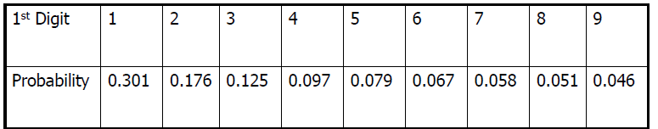
Example –Page 349, #6.26 BENFORD’s LaW
Ex: A large group of random numbers are taken. The following table shows the probability that the first digit will be the following numbers:
A = first digit is 1 B = first digit is 6 or greater
C = first digit is odd D = first digit is less than 4
Find the following probabilities:

Slide 43
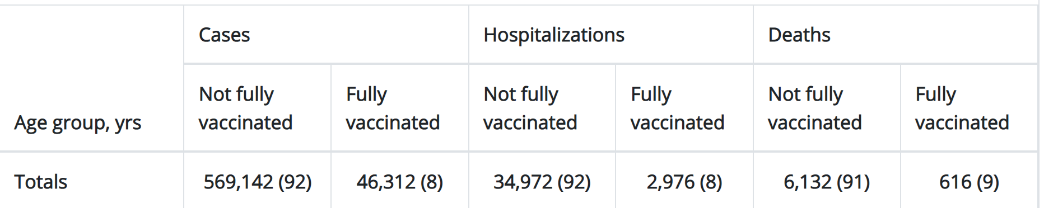
Cases
Hospitalization
Deaths
Fully Vaccinated
46,312 (8%)
2,976 (8%)
616 (9%)
NOT Fully Vaccinated
569,142 (92%)
34,972 (92%)
6,132 (91%)
https://www.cdc.gov/mmwr/volumes/70/wr/mm7037e1.htm?s_cid=mm7037e1_w

